Slide 1
Taylor Swift’s music video project
Present by: Jasmine Zeng

Slide 2


Project goal
Taylor is going to live + shoot documentary video with the crowd in one of NYC subway station
The shooting time could be anytime in summer (Jul/Aug/Sep)
The setting is Taylor will sing 2-3 songs and let the crowd realize it’s her
Find the best station (candidate stations) and the best time to perform live performance for Taylor

Slide 3
How it leads to final Result
1: From survey result, the largest portion of Taylor Swift’s fan are young adults.
2: Top 3 areas with the largest share of millennials
3: From candidate areas, select top stations with most traffic and form a list of 15 candidate stations, then narrow the list down by filtering traffic popularity and walkability.
4: Perform further data analysis to compare 3 candidate stations

Slide 4

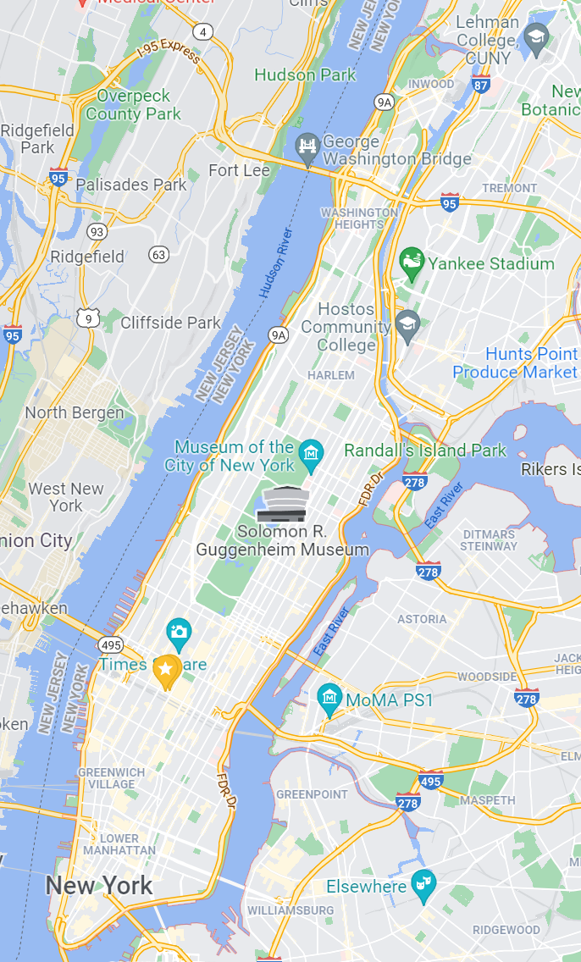
Top areas with Largest Share of Millennials
1. Downtown Manhattan
2. Garment District/ Murry Hill/ Kips Bay
3. Long Island City
3 Candidate Stations
1. Grand Central - 42 St
2. Times Sq – 42 St
3. 14 St – Union Sq
2
3
1

Slide 5
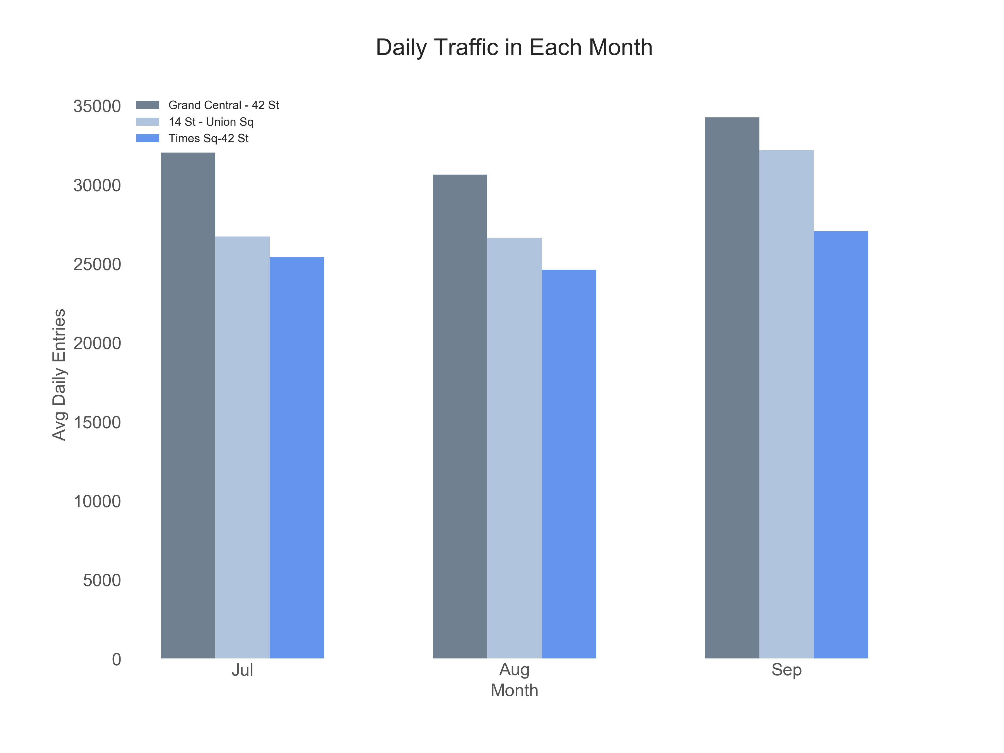
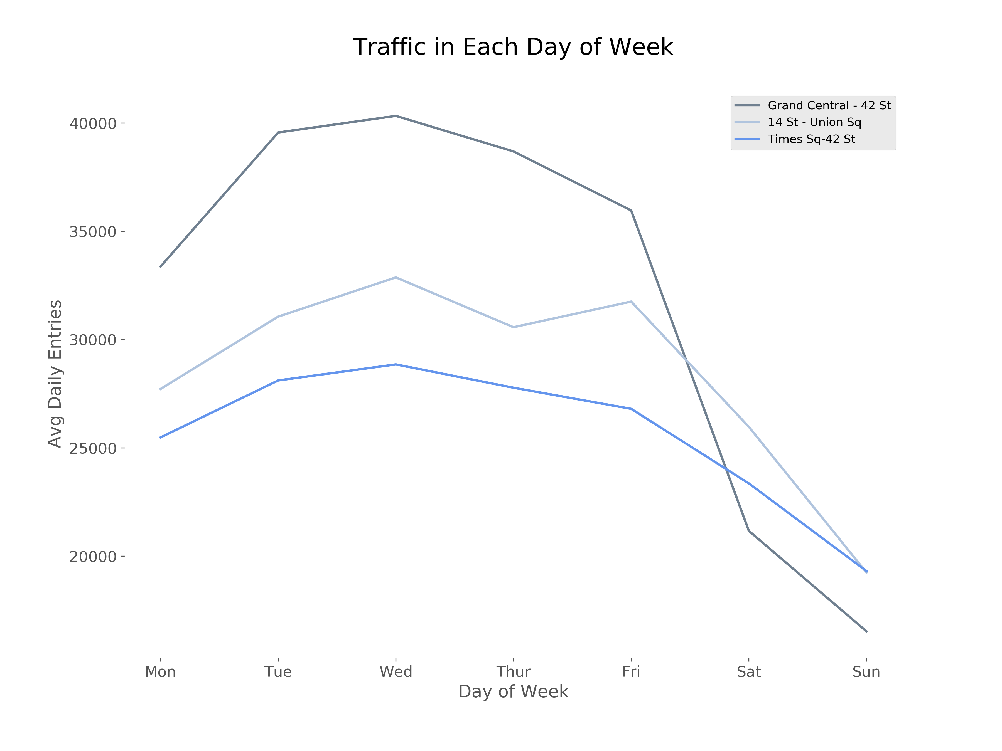
Traffic Analysis: Which month? And Which day of week?
Overall higher traffic in September, no big difference in July and Aug
Higher traffic on weekdays than on weekends

Slide 6
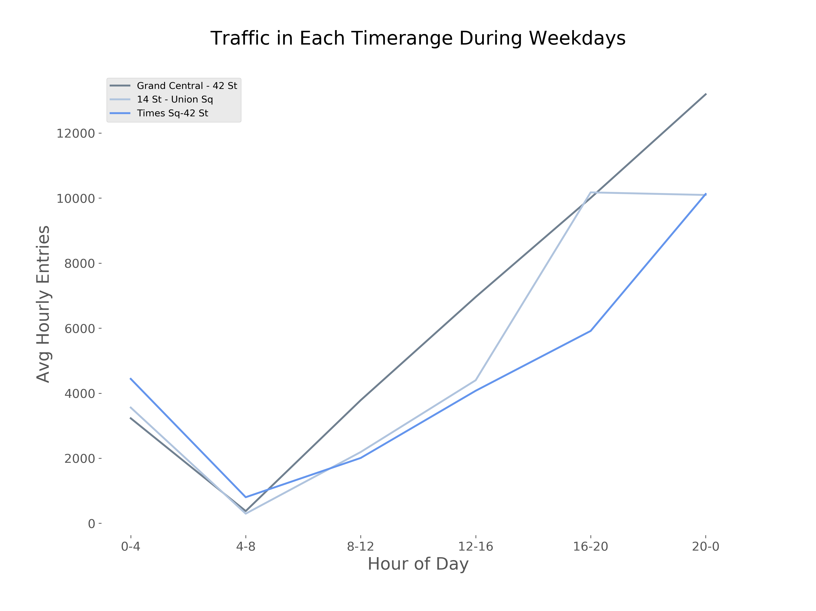
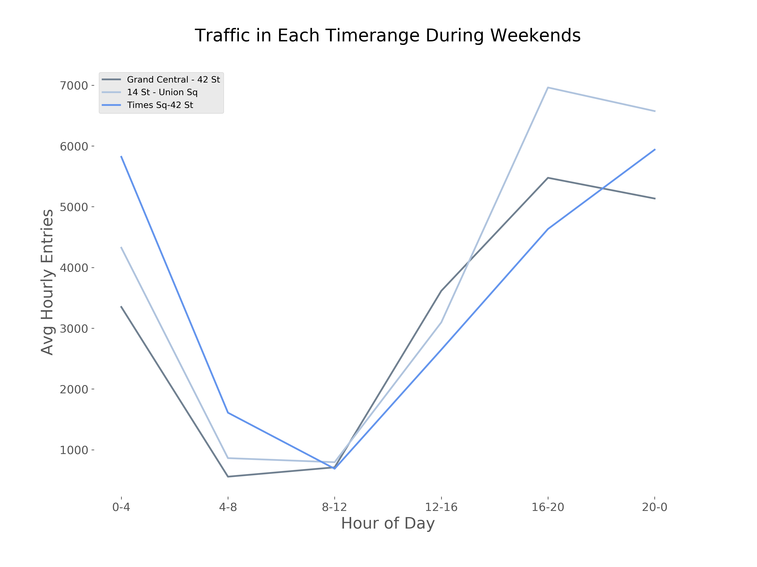
Traffic Analysis: Which time range of a day?
16:00-24:00 has the highest traffic across the week.
If going on weekends, 16:00-20:00 is preferred, because the flowrate will be higher, and you’ll have a bigger crowd which is good for filming.

Slide 7
Conclusion
Depends on Taylor’s schedule:
If July/August - Then Grand Central Station – 42 St is preferred, and filming time should be around 16:00-24:00 on weekdays to guarantee visitor flows
If September – Then all three stations have relative high traffic, both weekdays 16:00-24:00 and weekends 16:00 – 20:00 could guarantee visitor flows

Slide 8
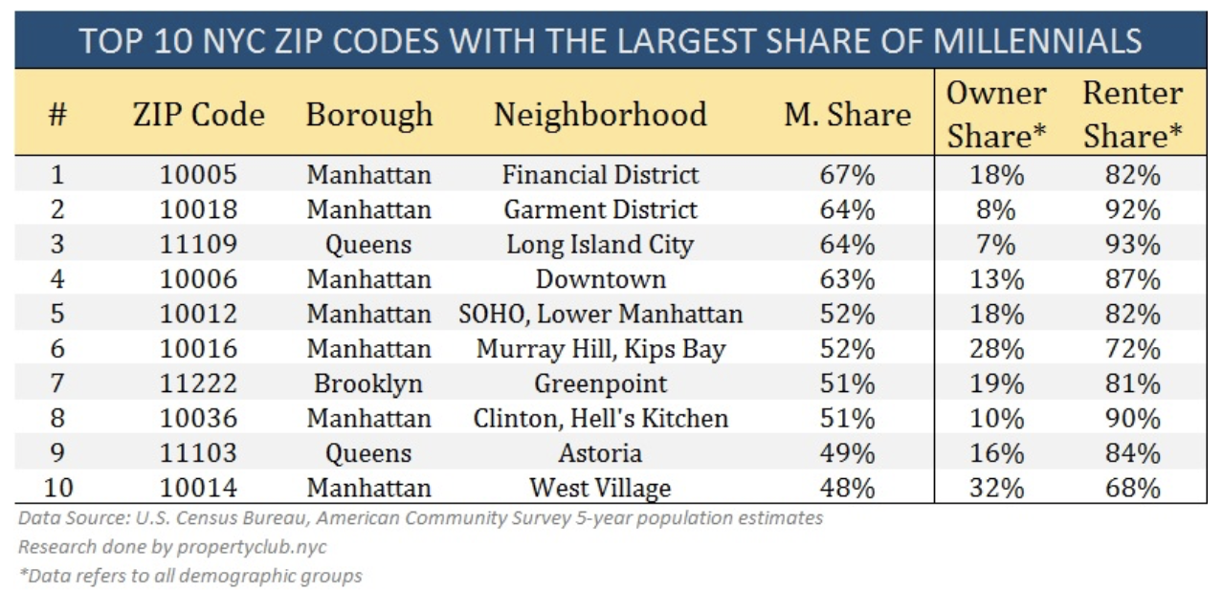
Appendix 1
Demographic of millennials in NYC

Slide 9
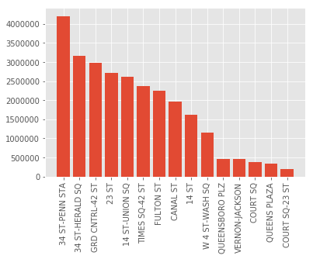
Appendix 2
Traffic by station
two popular choice:
47-50 Sts-Rockefeller: 1226092
Grand Central – 42: 2971456

